Slide 1
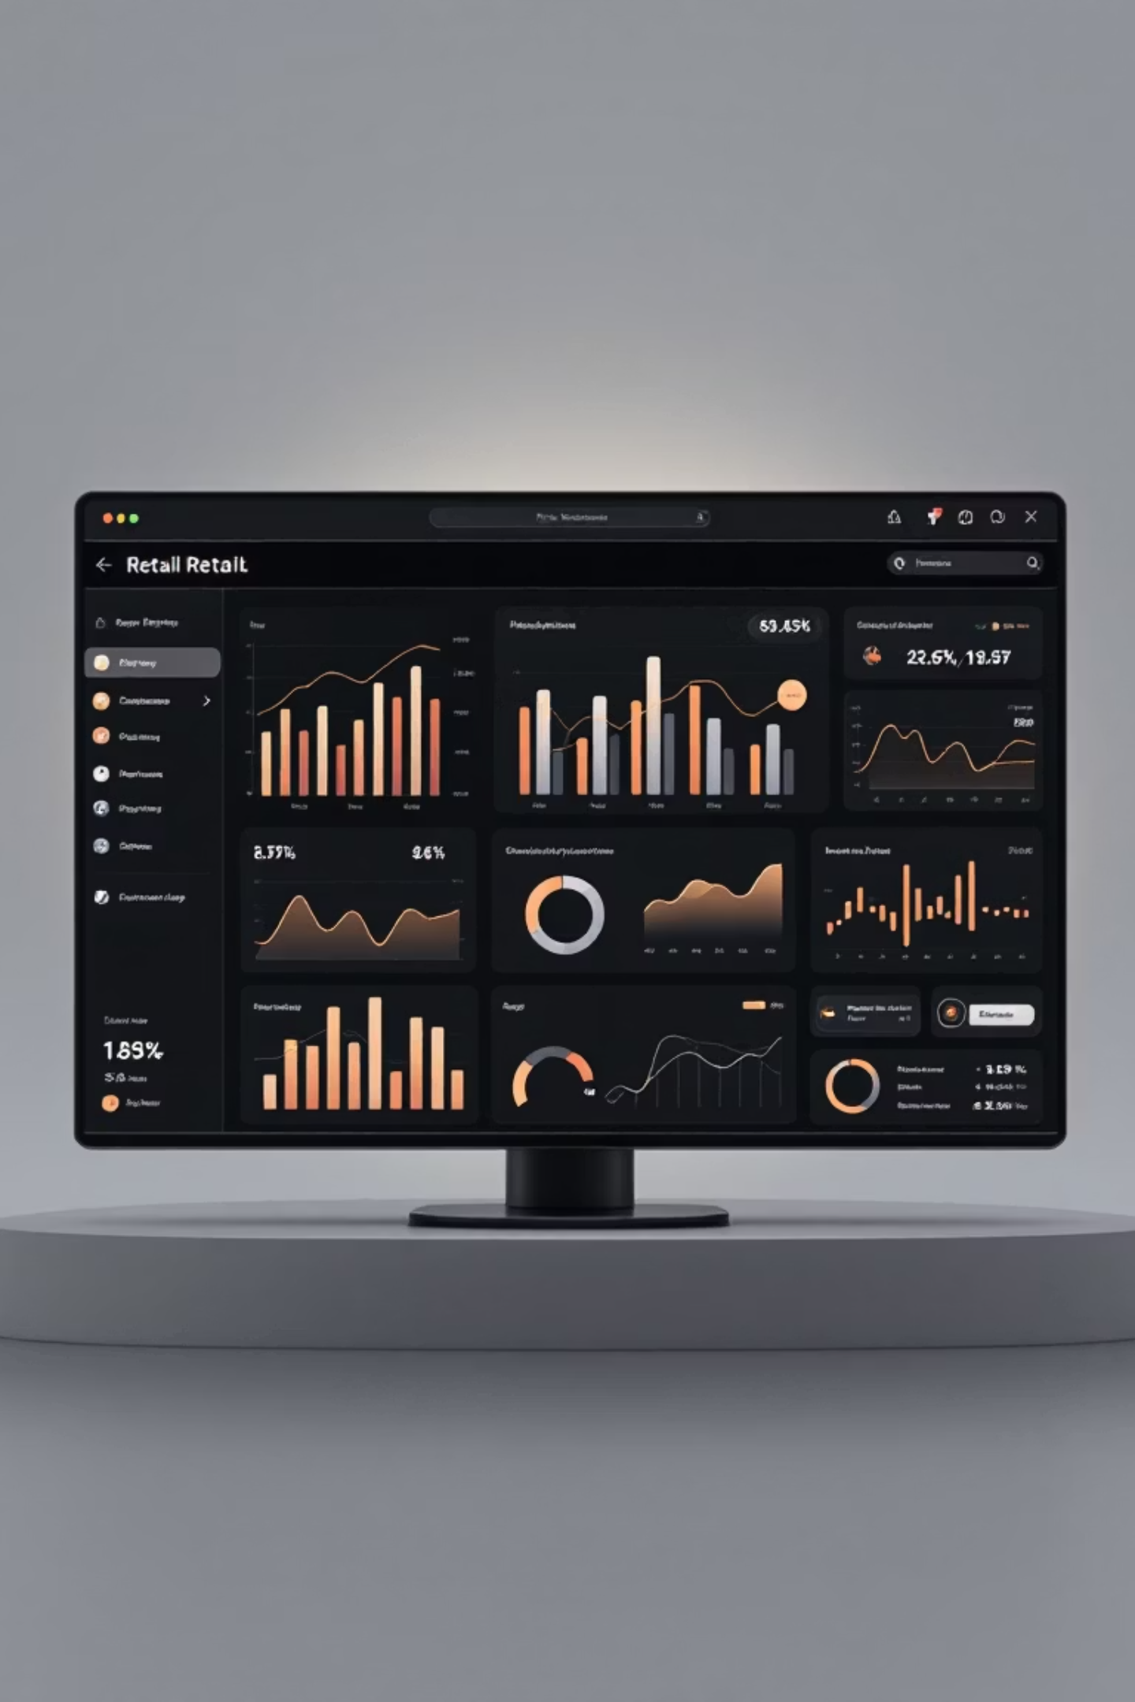
Customer Shopping Behavior Analysis
Uncovering insights from 3,900 purchases to guide strategic business decisions

Slide 2

DATASET OVERVIEW
The Foundation
3,900
18
50
$59.76
Total Purchases
Data Columns
Locations
Average Purchase
Transactions analyzed across all categories
Comprehensive customer and purchase attributes
Geographic diversity in customer base
Mean transaction value across all orders

Slide 3

PYTHON ANALYSIS
Data Preparation Journey
01
02
Data Loading & Exploration
Missing Data Handling
Imported dataset, checked structure and summary statistics
Imputed 37 missing review ratings using category medians
03
04
Feature Engineering
Database Integration
Created age groups and purchase frequency metrics
Connected to MySQL for advanced SQL analysis

Slide 4

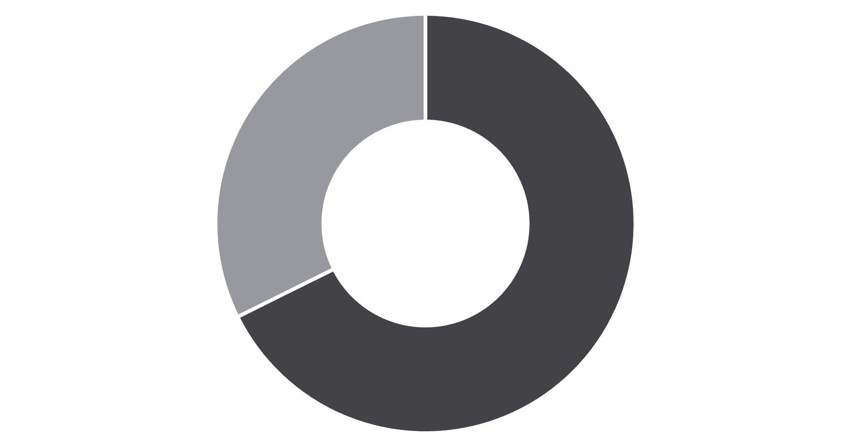
SQL INSIGHTS
Revenue by Gender
Male Dominance
Male customers generate 68% of total revenue, more than double female contribution
Strategic opportunity to increase female customer engagement
Male
Female

Slide 5


Top-Rated Products
77%
77%
76%
Gloves
Sandals
Boots
Highest average rating: 3.86/5
Strong performance: 3.84/5
Customer favorite: 3.82/5
76%
76%
Hat
Skirt
Consistent quality: 3.80/5
Top 5 performer: 3.78/5

Slide 6



Customer Segmentation Breakdown
New
1
83 customers
Returning
2
701 customers
Loyal
3
3,116 customers
80% of customer base classified as loyal, indicating strong retention but opportunity to convert new buyers

Slide 7

SUBSCRIPTION ANALYSIS
Subscribers vs Non-Subscribers
Subscribers
Repeat buyers with 5+ purchases show higher subscription rates, but 958 of them remain unsubscribed
1,053 customers (27%)
$59.49 average spend
$62,645 total revenue
Non-Subscribers
2,847 customers (73%)
$59.87 average spend
$170,436 total revenue

Slide 8
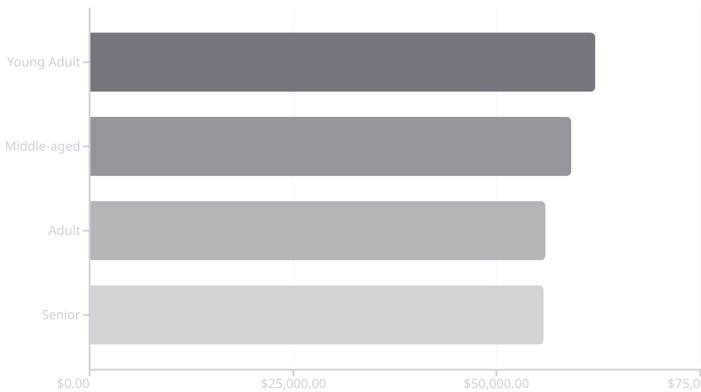
Revenue by Age Demographics
Young adults lead revenue generation, but all age groups contribute relatively evenly

Slide 9

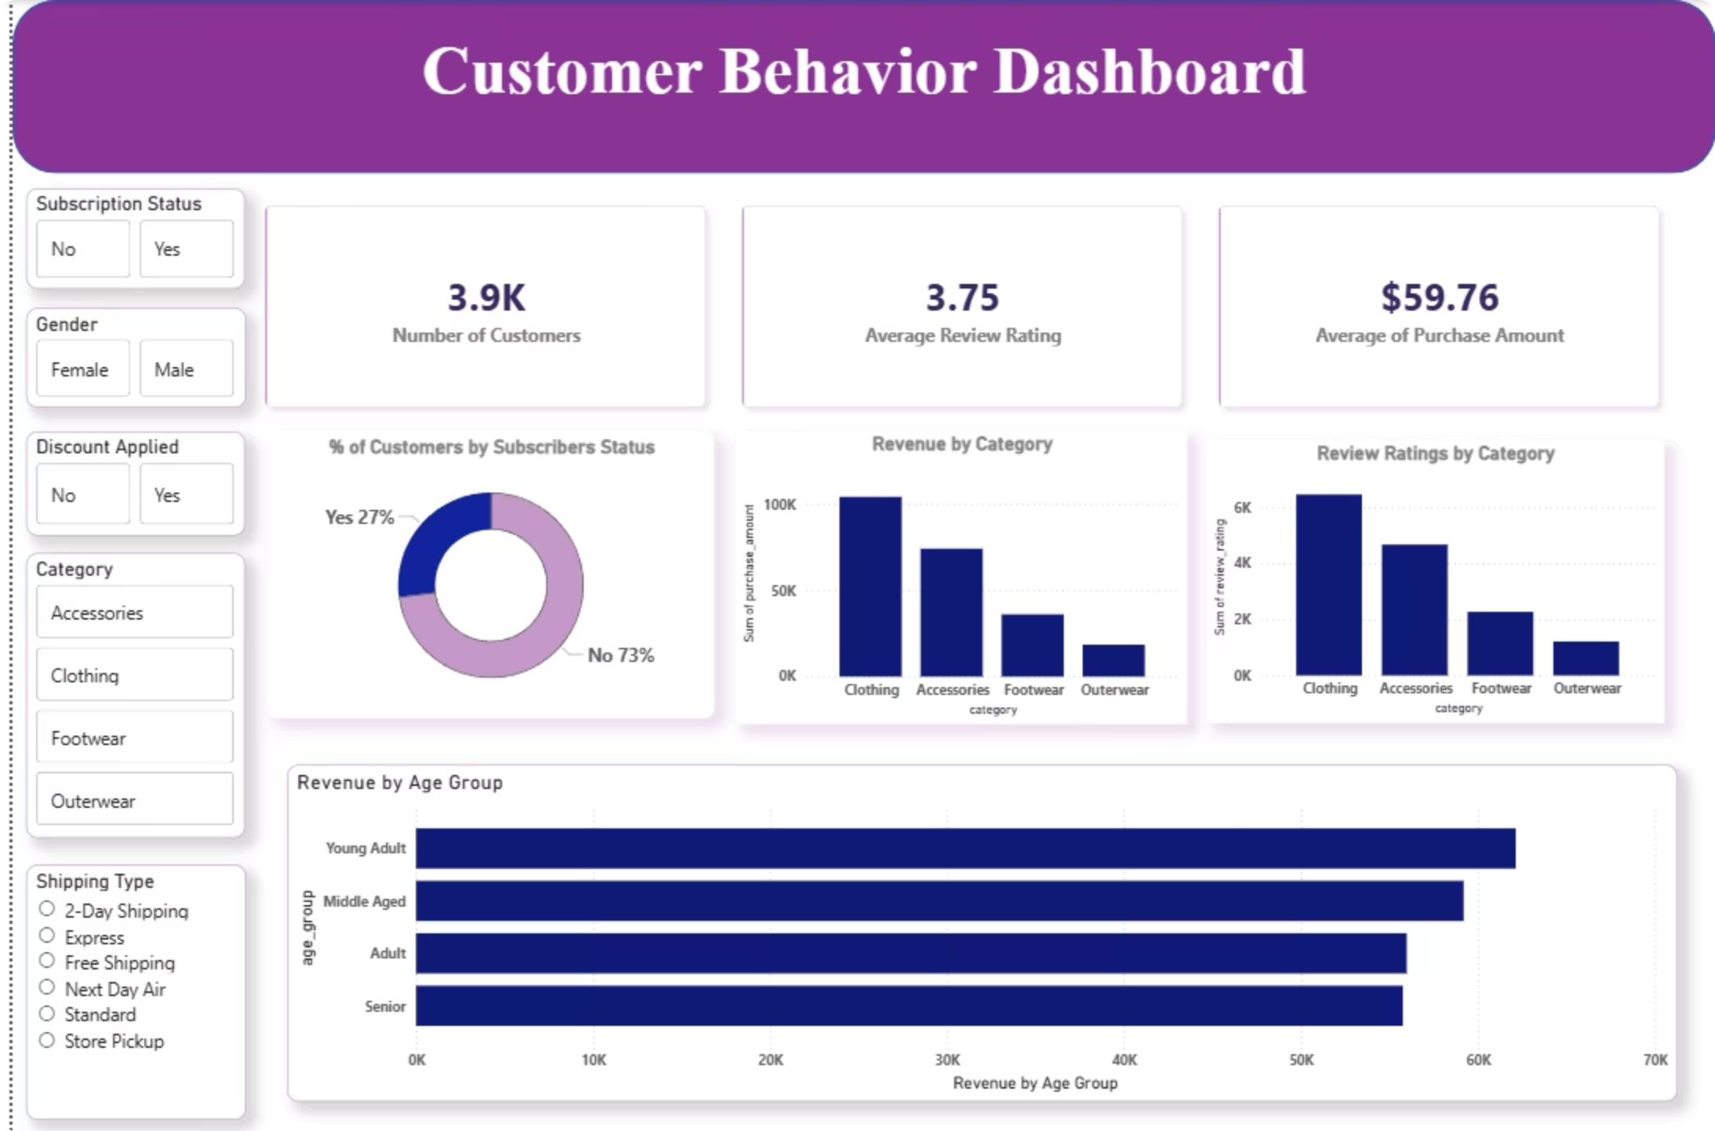

POWER BI
Interactive Dashboard
Comprehensive visualization bringing together all insights for real-time business intelligence

Slide 10
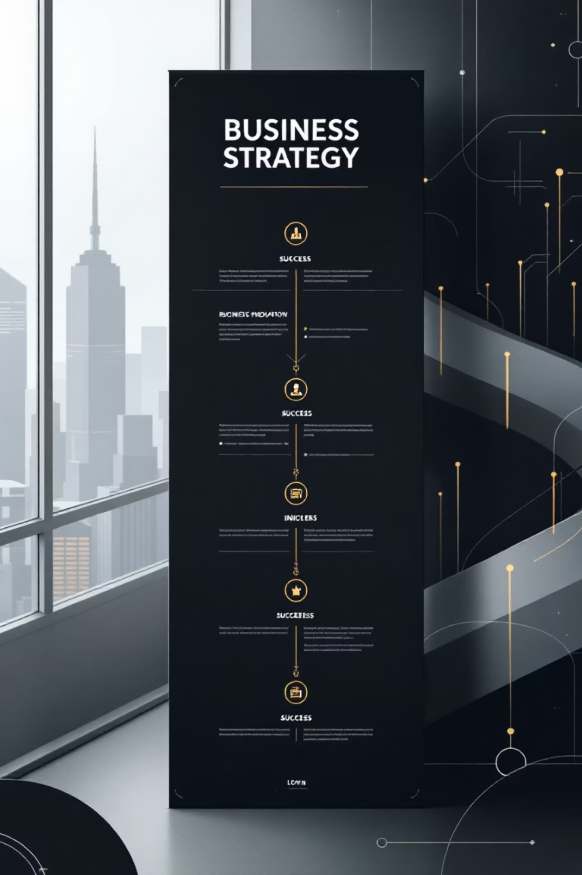




STRATEGIC RECOMMENDATIONS
Action Plan for Growth
Boost Subscriptions
Promote exclusive benefits to convert 958 repeat buyers
Loyalty Programs
Reward repeat buyers to strengthen retention
Product Positioning
Highlight top-rated items in marketing campaigns
Targeted Marketing
Focus on high-revenue segments and express shipping users

